Slide 1
Renewable Energy Forecast
Ryan Reiser, Mason Shandy, Brody Welch, Luke Hart

Slide 2
Challenge
Can we use various factors to predict how renewable energy generation will perform in the future?

Slide 3
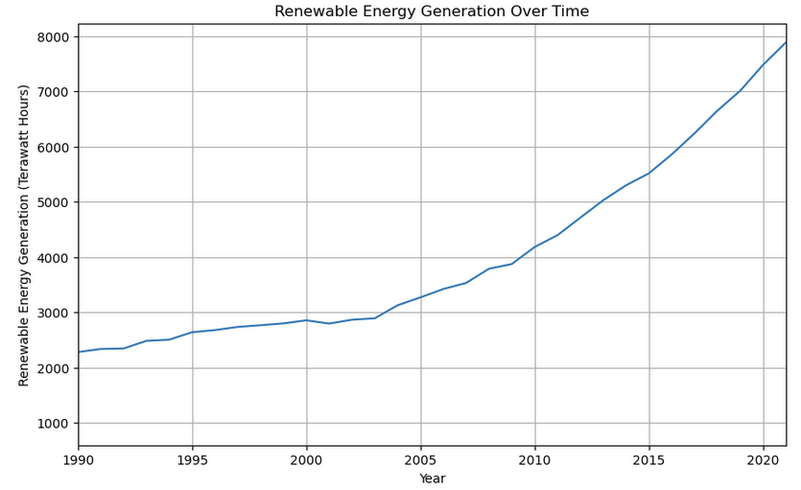
Importance of Renewable Energy
Essential for the future due to limited fossil fuel and climate change.
Our model predicts renewable energy generation using these factors:
Fossil fuel prices
Fossil fuel consumption
Natural disaster deaths
Global GDP

Slide 4

Key Factors Impacting Renewable Energy
Fossil Fuel Price:
Higher prices increase demand for renewables.
Fossil Fuel Consumption:
May indicate less demand for renewables in the short term.
Natural Disaster Deaths:
Proxy for climate change awareness, correlated positively.
Global GDP:
Higher GDP enables more investments in renewable technologies.

Slide 5
Data Collection
Fossil Fuel Consumption and Production
Climate Change
Global Energy Consumption & Renewable Generation
Global Economic Monitor
International Monetary Fund
Our World in Data
World Bank Group
Kaggle

Slide 6
Methodology
Data Sources:
Fossil Fuel Prices:
Historical pricing trends
Fossil Fuel Consumption:
Global usage data
Natural Disaster Deaths:
Proxy for climate-related events
Global GDP:
Economic capacity for renewable investment
Renewable Energy Generation:
Annual data in Terawatt Hours (TWh)
Method:
Regression analysis with log-transformed variables
Evaluating relationships and statistical significance

Slide 7
Results & Key Findings
Fossil Fuel Price:
62% Correlation
P = 0.001; t = 3.828; R² = 0.379
Coefficient: 0.4
Fossil Fuel Consumption:
97% Correlation
P = 0.000; t = 31.739; R² = 0.948
Coefficient: 1.6
Global GDP:
97% Correlation
P = 0.000; t = 24.432; R2 = 0.949
Coefficient: 1.1
Natural Disaster Deaths:
-0.19% Correlation
P = 0.202; t = -1.295; R2 = 0.037
Coefficient: -0.05

Slide 8
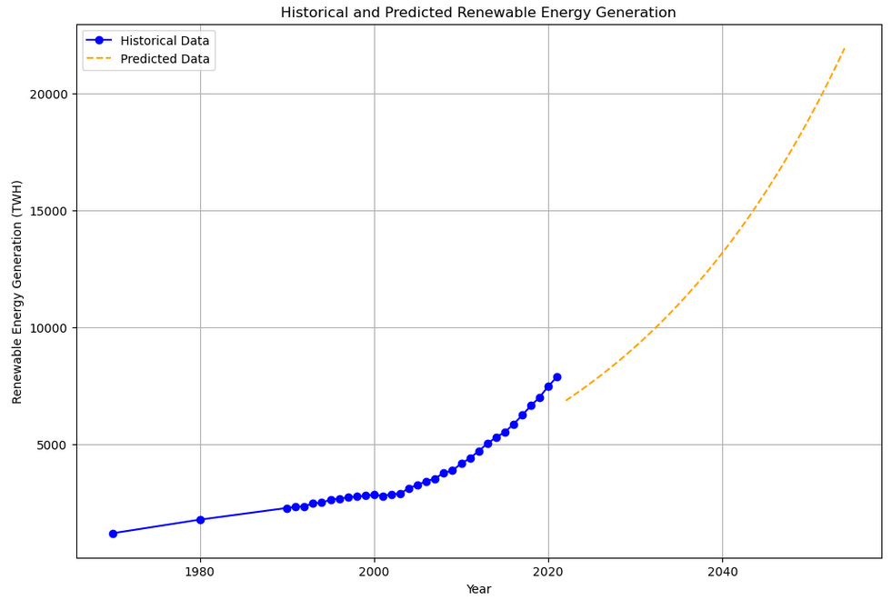
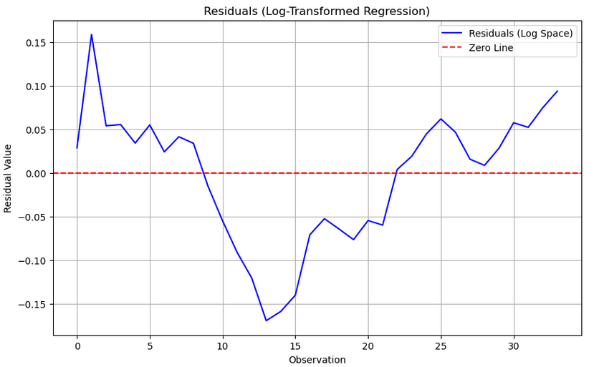
Linear Regression Model

Slide 9
Conclusions
Significant Factors
Importance
Projection
Fossil Fuel Prices
Fossil Fuel Consumption
Global Economic Conditions
Statistically significant relationships inform policy and investment
Steady growth of Renewable Energy Generation for decades

Slide 10
Thanks!
Questions, comments?

